Slide 1

Automatic Ticket Assignment
Capstone project - Automating the task of ticket assignment by using advanced machine learning algorithms
By,
Madhumitha.R
Harika.M
Deepkumar Aravindkumar Patel
Rachit Vaid

Slide 2
Week-1
Business Understanding and project approach

Slide 3
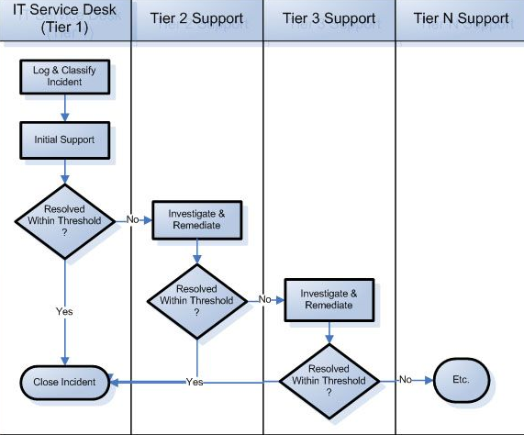
BUSINESS SCOPE – INCIDENT MANAGEMENT PROCESS
An incident is something that is unplanned interruption to an IT service or reduction in the quality of an IT service that affects the Users and the business
To provide a quick fix / workarounds or solutions that resolves the interruption and restores the service to its full capacity to ensure no business impact

Slide 4
Problem Statement
Scope for improvement
Automate the process
Time taken reduced immensely
Cost saving/cutting
Eliminates human error. Model accuracy is better than human error.
Thus, Improves customer satisfaction
Requires manual testing
Time consuming
Need human resource
Susceptible to human error, e.g. approximately 25% of Incidents are considered to be wrongly assigned to functional teams.
Can lead to user satisfaction detoriation

Slide 5

Data source and ITS CHALLENGES
Already assigned and closed ticket data history is needed
It is subjected to manual error
Missing data
Data that failed to be recorded in the system
Require minimum of 100-200 tickets per group
Need sufficient storage space and computation requirements

Slide 6
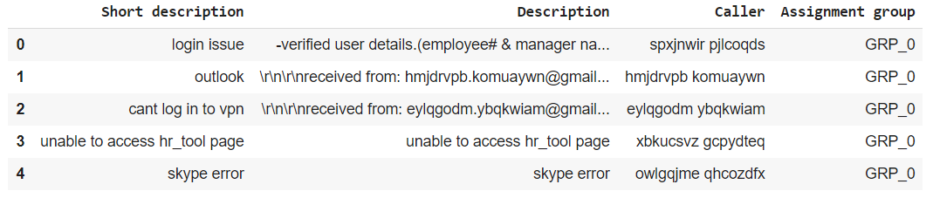
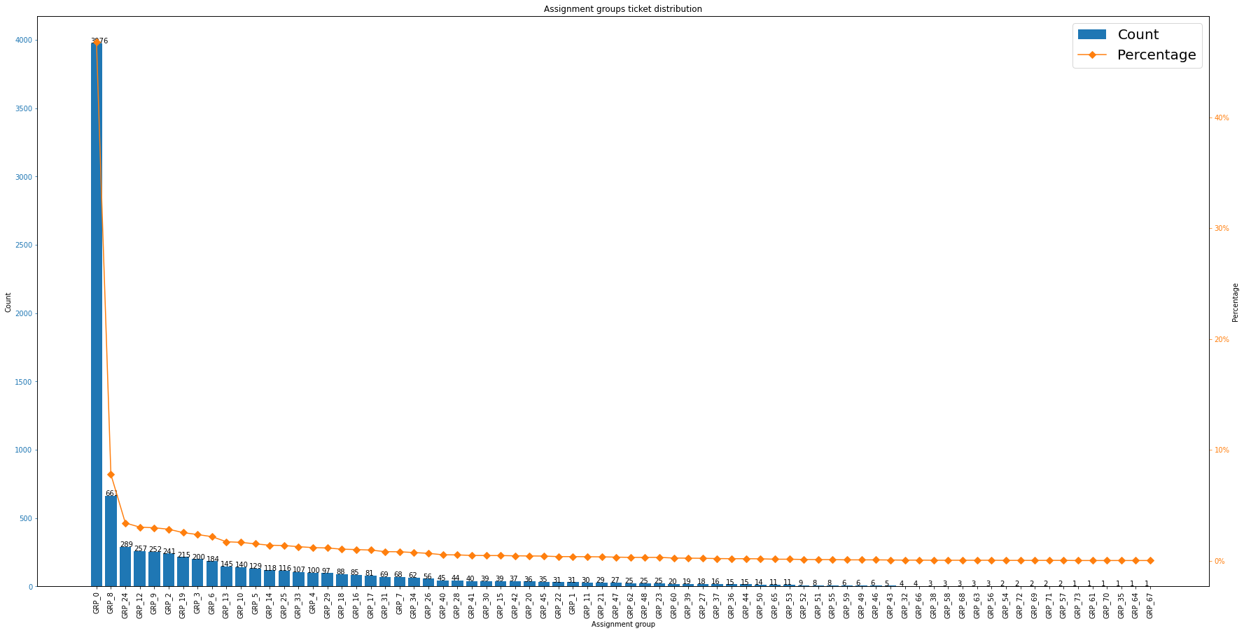
Dataset characteristics
There are 74 unique assignment groups to which the 8500 received tickets are assigned.
There are NULL values in short description and description columns
Some data are in language different than English. e.g. German
GRP_0 has nearly half of the total number of tickets received
Some ticket assignments with a frequency of less than 100.
A lot of groups with only ticket assigned which do not add much value

Slide 7
Solution METHODOLOGY
Verify data quality
Data pre-processing
Clean, format data
Tokenization, remove stop words, normalization, stemming & lemmatization, feature engineering (TF-IDF, N-gram, GloVe)
Modelling
Evaluation
Accuracy, Precision, recall, F1-score, AUC, val-loss
Understand data structure
Perform EDA
Finalize dataset
Train/test data split
Alter hyper parameters, find better working model
Deployment
User Integration
Analyze production environment
Monitoring and maintenance
Use NLP models like RNN’s, LSTMS and other advanced models
Data Analysis
Business Understanding
Determine the business objective
Set overall goals to achieve
Finalize on milestones to target

Slide 8
Week-2
EDA & PREPROCESSING

Slide 9
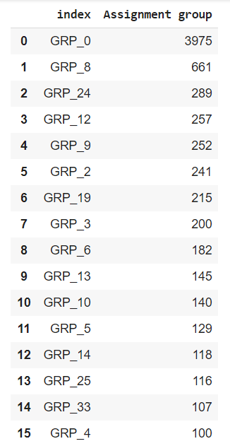
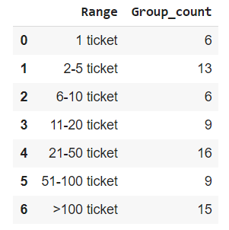
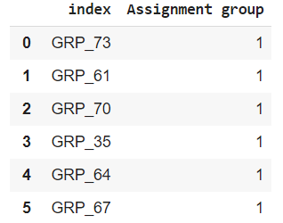
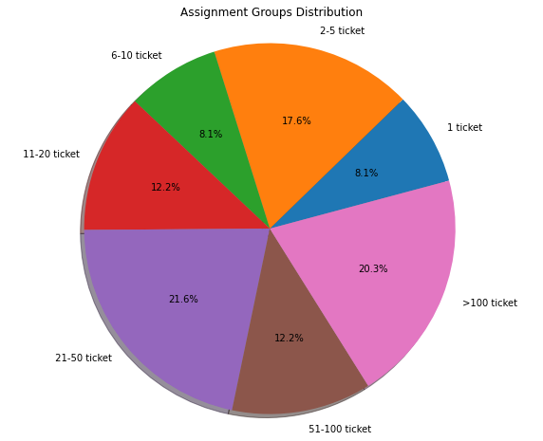
EXPLORATORY DATA ANALYSIS
Ticket >=100
Target column distribution
Ticket Distribution
Ticket =1
There are 6 groups that has only one ticket - 8.1%. These tickets are deleted, since they do not add value to the prediction.
There are 15 assignment groups that has more than 100 tickets - 20.3%

Slide 10
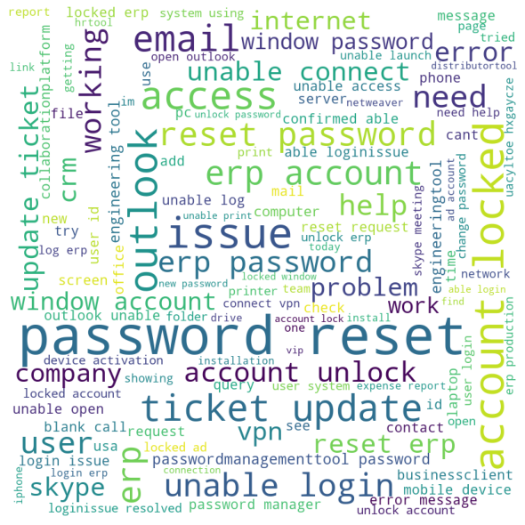
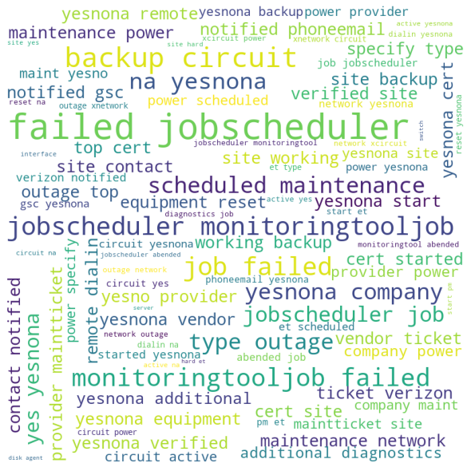
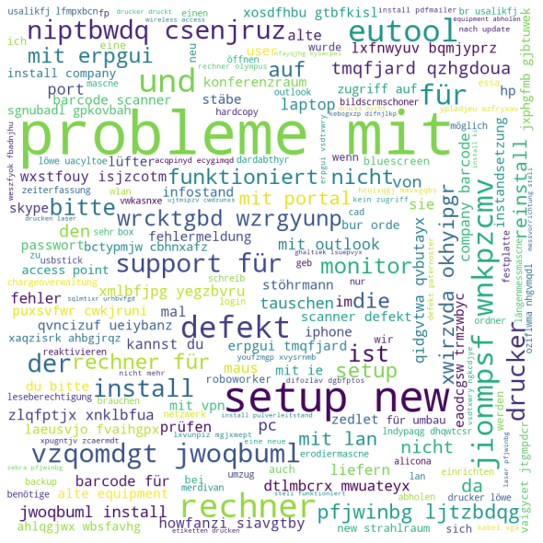
Top 3 Assignment-Group Wordcloud
Group 0 – Login issue
Group 8 – Job Scheduling
Group 24 – Needs Translation

Slide 11
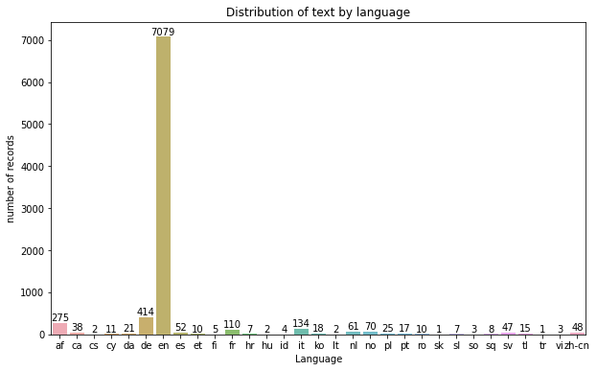
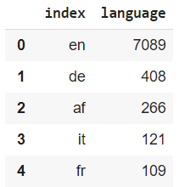
Language distribution
We can see that most of the tickets are in English, followed by tickets in German, African, Italian, French language.
Translate into English is required for standardization

Slide 12
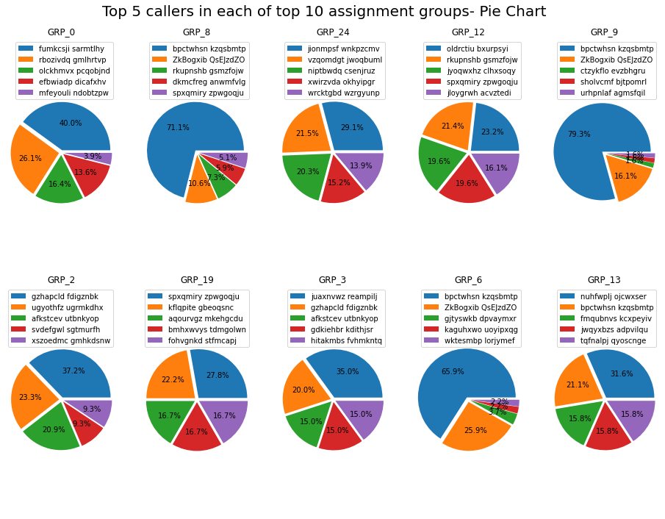
Caller Insights
There are overall 2950 callers in the dataset.
15 callers are involved in raising tickets for multiple assignment group, overall contributing to 281 tickets in the dataset.
The top 5 caller ticket distribution in every group is widely distributed almost having a balanced distribution. This indicated that most of the group resolves issues widely over various field impacting business

Slide 13
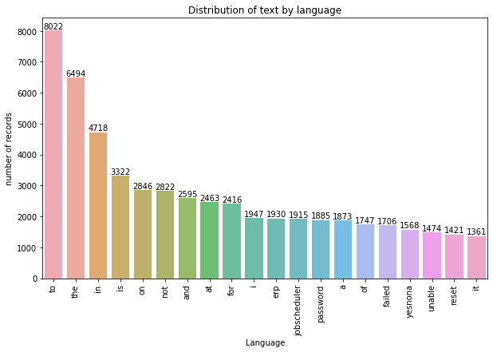
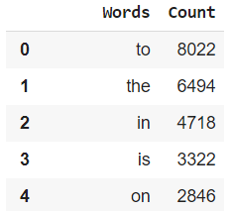
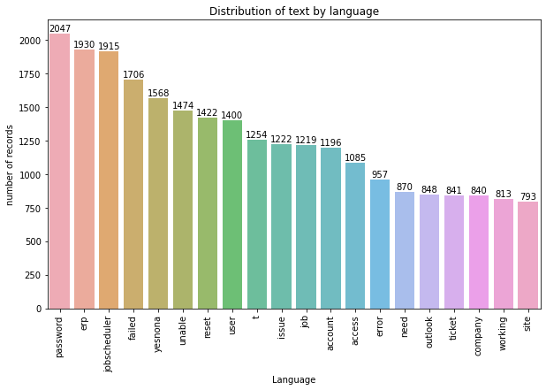
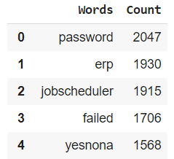
DATA Pre-processing
Before data cleansing
Data Cleaning
There were 9 rows with NULL values. Replaced them with empty string.
Detected and cleaned data with Mojibakes using ftfy library.
Converted all text to lower case
Used regex to remove special characters, punctuations and unwanted text like receive, from, sent, to etc.
Removed stop words from description and created clean text.
After data cleansing

Slide 14
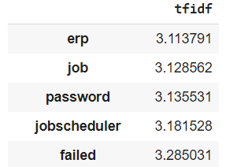
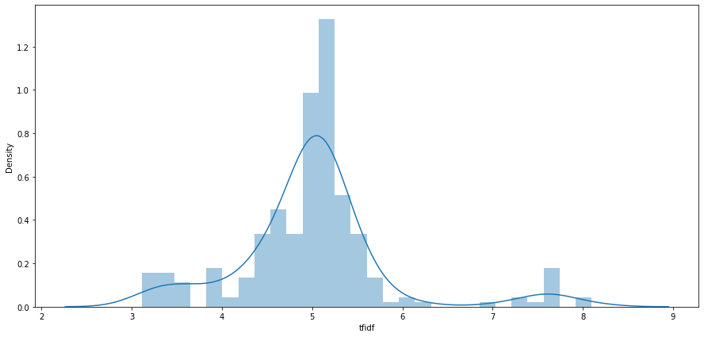
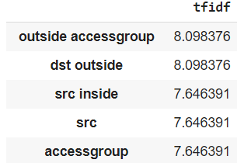
Feature engineering
Merged short description and description to create new feature.
Stemming, Lemmatization, Tokenization done on the merged new feature
Create new feature by calculating no of words, average words, unique words, total length.
Drop tickets that have less than one word in description.
Calculate Uni-gram, Bi-gram, trigram
Calculate TF-IDF
Latent Dirichlet Allocation (LDA) Topic Modelling
Label-encoding target column.
TF-IDF Distribution
Top Insignificant Words
Top Significant Words

Slide 15
Latent Dirichlet Allocation (LDA) Topic Modeling
Topic 0
password
Topic 1
yesnona
Site
pc
alert
Change
password reset
reset password
Log
Passwordmanagementtool
Tool
New
engineering
Reset
Topic 3
Topic 4
Topic 5
Topic 6
Topic 7
Topic 8
Topic 9
Power
Circuit
Backup
Topic 2
backup circuit
Outage
Et
Company
na
uacyltoe
für
probleme mit
die
und
probleme
mit
nicht
erp
erp account
unlock
window
Password reset
locked
account
reset
password
locked
account
user
able
connection
unable
system
need
company
id
login
access
unable
telephonysoftware
connect
unable
collaborationplatform
open
file
connect
call
vpn
skype
ticket
jobscheduler
issue
event
deny
inside
via
host
asa
number
ip
tcp
phone
get
message
need
crm
printer
working
email
outlook
error
jobscheduler
job
abended
monitoringtooljob failed
job failed
jobscheduler monitoringtooljob
monitoringtooljob
information
check
create
delivery
ticket update
order
server
update
device
failed

Slide 16
Week-3
Model Building

Slide 17
Modelling APPROACH
Statistical ML Models
Multinomial Logistic Regression
Support Vector Machine
Stochastic Gradient Descent
Multinomial Naive Bayes
K Nearest neighbour
Random Forest
Decision trees
Xgboost
This project is a multiclass classification problem. Machine Learning models that support it, such as K-NN, Naïve Bayes, Decision Tree etc., are used.
Modelling is done with the cleaned and processed data (imbalanced) obtained from pervious steps.
All basic statistical models are used preceded by advanced neural network models .
Identify best performing models based on comparing their performance metrics
Perform various fine tuning strategies to improve model performance
Deep Learning Models
Deep Neural Network
Convolutional Neural Network
Recurrent Neural Network
Recurrent Convolutional Neural Network
LSTM
Bi Direction LSTM

Slide 18
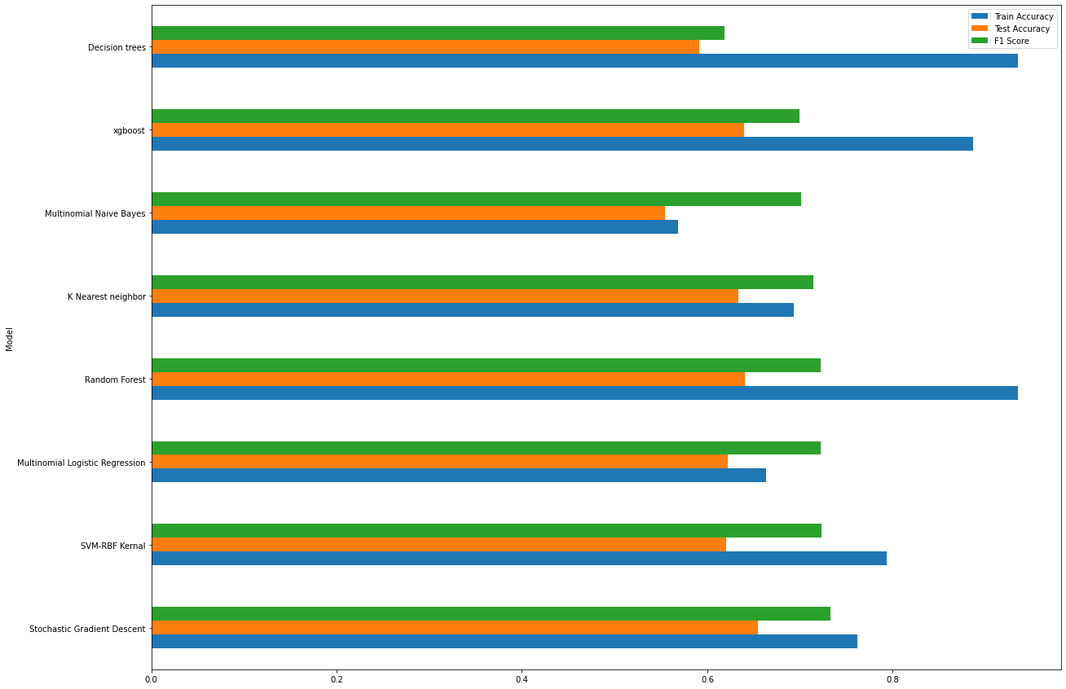
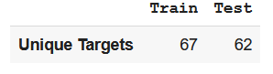
Statistical ML Models Performance
Random forest, Xgboost and Decision Tree seems to be overfitting due to high difference in Training and test accuracy
F1 score is higher than accuracy because it is calculated for the target group present in y_pred(lesser than the y_train) – Class Imbalance
Top 4 highest accuracy model
Stochastic Gradient Descent – 65.54%
Random Forest – 64.07%
Xgboost – 64%
K Nearest Neighbour – 63.36%

Slide 19
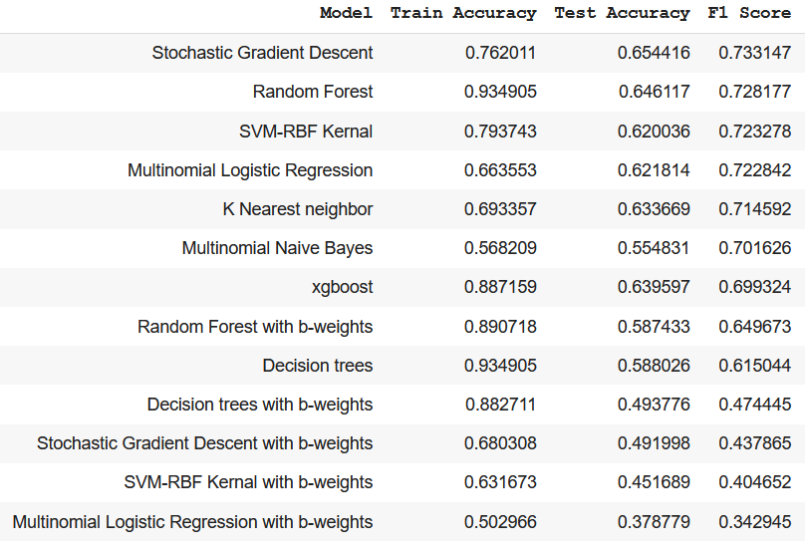
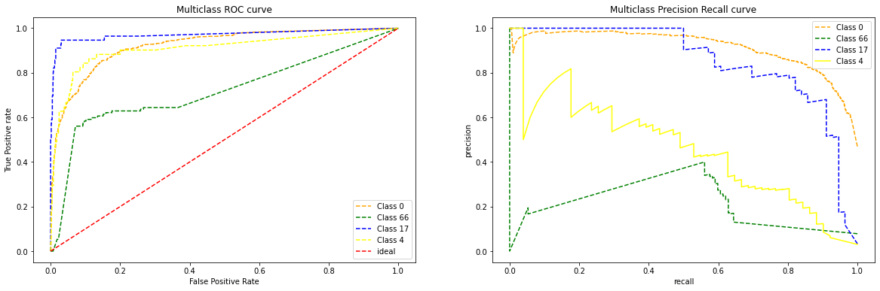
STATISTICAL model - performance ANALYSIS
The best performing model “Stochastic Gradient Descent” performance reduces drastically from 65.44% to 49.19% once the parameter class_weight = ‘balanced’
K-NN, Xgboost and Random Forest seem to handle imbalance better than SGD.
Meanwhile, SGD, SVM and Naïve Bayes might perform better if the class imbalance is taken care

Slide 20
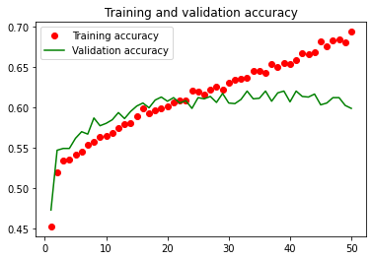
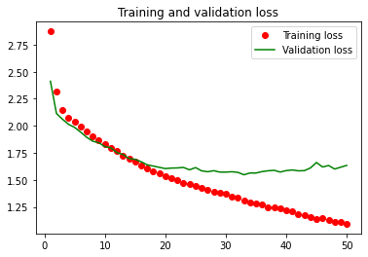
Deep Learning model
NN Model
X = TF-IDF vectorized data(max_features=250), Y = Label encoded data
Optimizer = ‘sgd’, Activation function = ‘relu’ including dropouts()
LSTM/RNN improvement can be achieved with further word embeddings such as bag of Words, word2vec,
Deep Learning Model | Accuracy
Neural Network | 0.62
Convolution Neural Network (CNN) | 0.48
Recurrent Neural Network (RNN) | 0.60
LSTM | 0.63

Slide 21
SCOPE FOR FINE TUNING AND PERFORMANCE IMPROVEMENT
Dataset Centric Approach
Model Centric Approach
Rectify dataset imbalance
Up-sampling,
Down-sampling,
Remove group with less than 30 tickets each
Club the top groups will less tickets each
Create new groups from Group_0 using LDA.
Remove or group tickets with foreign language
Combine some or all the above steps
Add more features such as word count, avg, LDA_topics.
Hyper parameter tuning
Ensemble models such as stacking of top performing models
Transfer Learning
Advance NLP models like BERT, XLNet etc.

Slide 22
Week-4
Model performance tuning

Slide 23
Selected models
All Statistical Models
Multinomial Logistic Regression
Eliminating based on time
Multinomial Logistic Regression
Eliminating based on performance
Multinomial Logistic Regression
Support Vector Machine
Multinomial Naïve Bayes
K-Nearest Neighbors
Random Forest
Decision Tree
Stochastic Gradient Descent
XGBoost
Random Forest
Decision Tree
Random Forest
Neural Network
Neural Network
Neural Network
LSTM
LSTM
LSTM
Basis for model selection
SVM (RBF Kernel) and Xgboost seems to take a lot of time for execution.
K NN and Random Forest seem to handle imbalance better than SGD.
TF-IDF vectorized input improves the performance for Multinomial Logistic Regression, Random Forest, Decision Tree. But it fails to converge for SVM, Naïve Bayes, Stochastic gradient & KNN.
Top the performing models with vectorized input are considered
Model Selection Approach

Slide 24
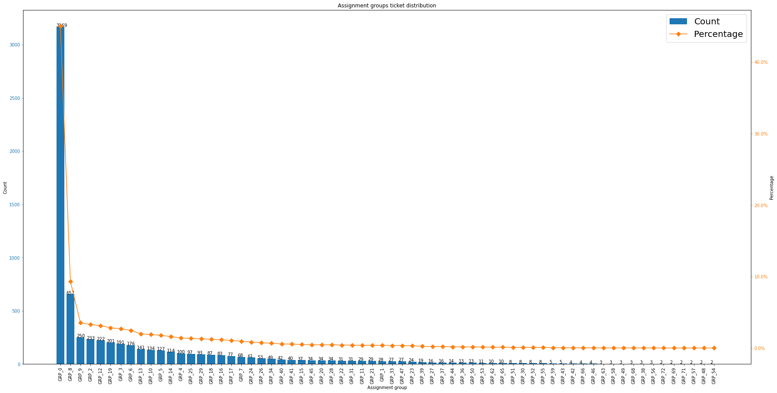
DATA CENTRIC TUNING
Data Cleansing
Remove tickets non-English description – 16.69%
Remove groups with one ticket each.
After removing foreign language tickets

Slide 25
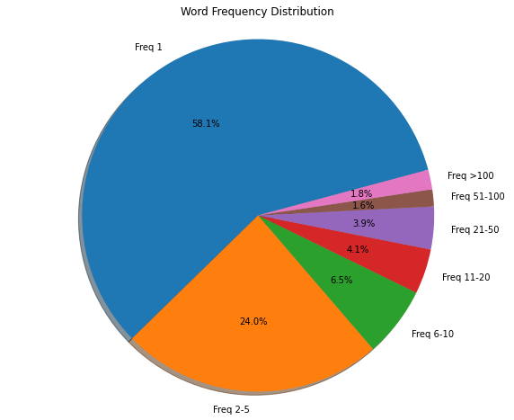
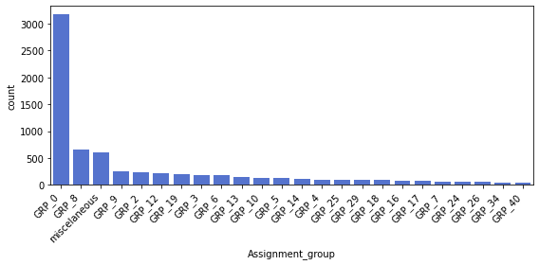
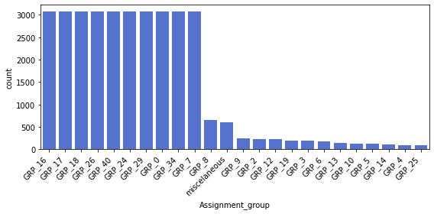
Feature extraction
Add features based on word count, word count average, length. – Did not add value
Combine group with no of ticket less than 40 into miscellaneous group – to reduce imbalance – reducing to 24 labels
Words frequency greater than 50 contribute to only 3.4 percent. These might add to noise. Thus can be removed from vectorization. Ideal TF-IDF – 9668
Sampling
Edited Nearest Neighbours (Down-sampling: ’Majority’)
Repeated SMOTE (Up-sampling: ’Minority’)
Final dimension - 3394 * 9669

Slide 26
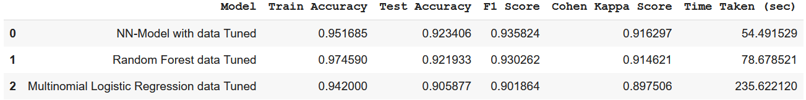
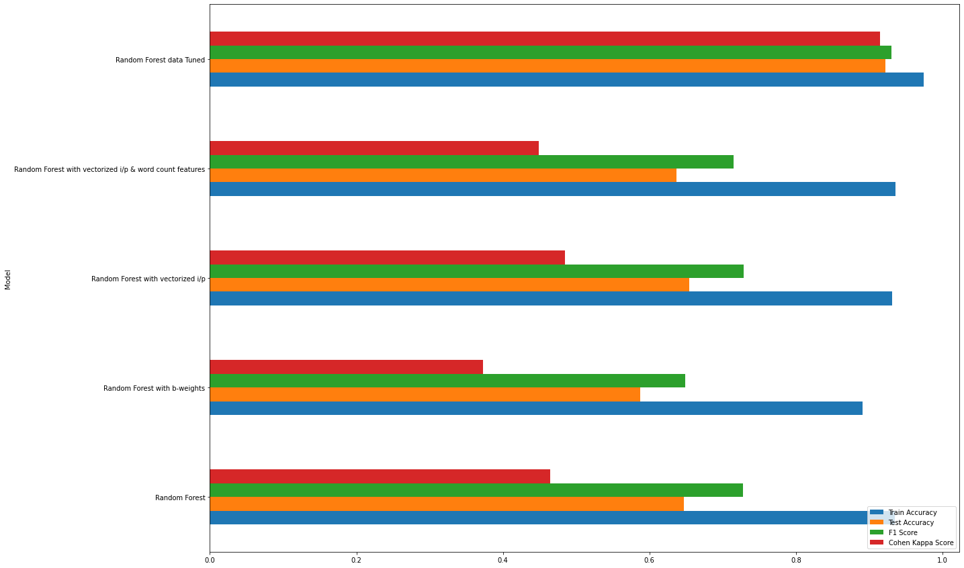
Model Performance
Kappa & F1 score is considered as one of the main metric because of data imbalance
Model performance for all the selected models have improved vastly from 0.3 to 0.9 kappa score
Apart from hyper parameter tuning further performance improvement can be done by stacking the random forest and Logistic regression

Slide 27
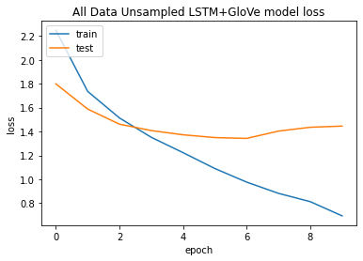
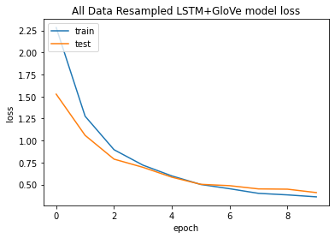
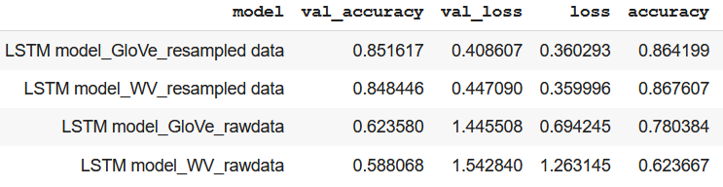
NLP MODEL PERFORMANCE
Performance Tuning
Sampling –
Instead of previous sampling, down-sampled further using basic resampling method and up-sampled – For faster modelling
Final dimension - 15768 * 9669
Embedding –
word2vec and glove100d data.
Glove data had a better performance – 85.16%.
Further performance improvement can be done by identifying ideal epoch, batch size, no. of layers, layer density, dropout, learning rate, etc as well as trying advance NLP models like BERT.
LSTM +GloVe Loss

Slide 28
Final model performance
S.no | Model | Validation Accuracy
1 | Neural Network | 92.34
2 | Random forest | 92.19
3 | Multinomial Logistic Regression | 90.58
4 | LSTM with GloVe | 85.16
5 | LSTM with word2vec | 84.84

Slide 29
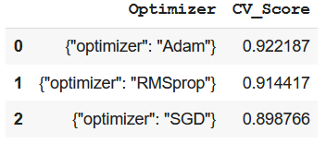
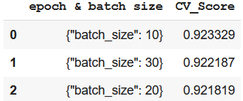
Hyper Parameterization
Best parameter values for NN after performing grid search CV.
Layers = 7
Dense = 200, 100, 50, 24
Dropout = 0.6, 0.5, 0.1
Optimizer = Adam
Loss = 'sparse_categorical_crossentropy’
Epoch = 10, batch size = 10
Learning rate = 0.001
Improvement in accuracy by 1% is achieved 92.34 -> 93.21

Slide 30
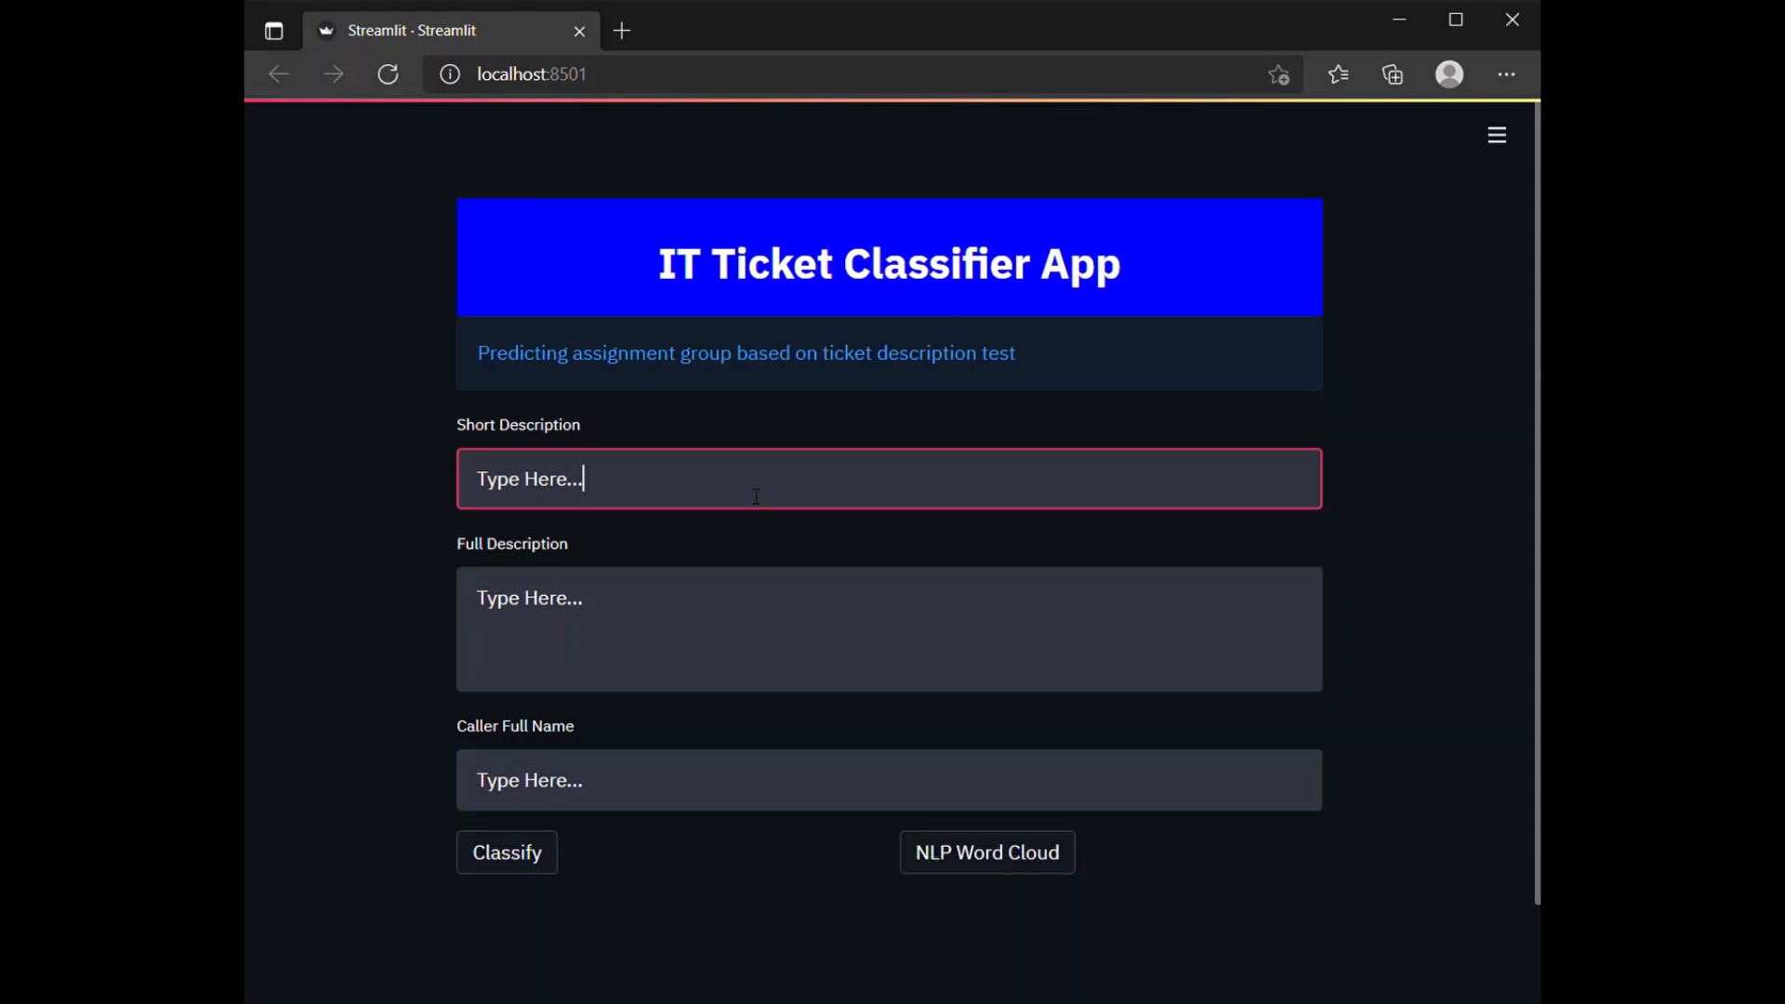
Machine Learning app

Slide 31
Conclusion
S. no | Drawbacks | Reason | Future Scope
1 | Non-English tickets need to be translated manually | Automating translation of huge dataset using Google API is challenging | Research and overcome the challenge of automatic translation
2 | Failing prediction of assignment groups clubbed into miscellaneous group | High imbalance in the no of tickets per assignment group | Create a separate prediction for tickets classified under miscellaneous as well as work on getting more training tickets under these groups.
3 | Unable to perform advance sampling methods and use models like LSTM and Advance models | Shortage of RAM space and absence of parallel processing | Use higher RAM size and multiple processors

Slide 32
THANK YOU

